Slide 1
Large Scale Automated Refactoring
June 2021

Slide 2
For code, maintainability is destiny.
CALL TO ACTION.
20-30% of our time is spent on tedious code maintenance. Code maintenance feels like doing the dishes.
As developers, we are left begging our business to let us do maintenance. We actually beg to do the dishes. Does this seem right?

Slide 3
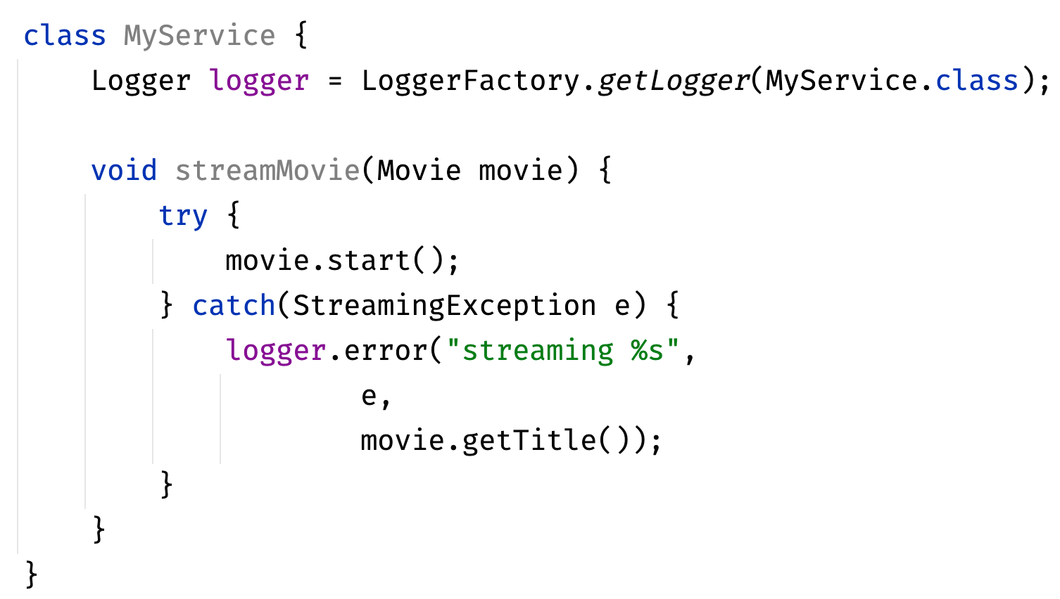
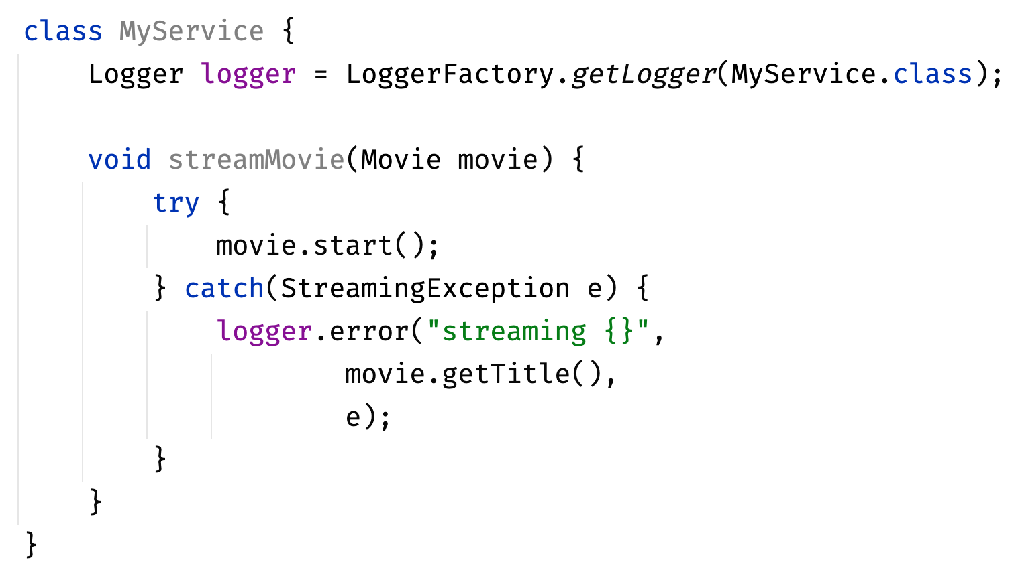

Netflix platform team can't remove internal logger 6 years after deprecating it for SLF4J.
TRANSFORMATION.

Slide 4
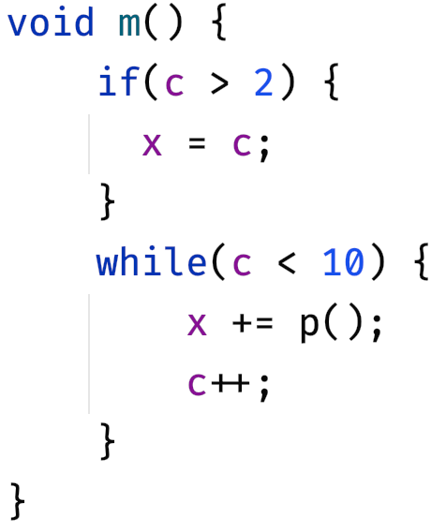
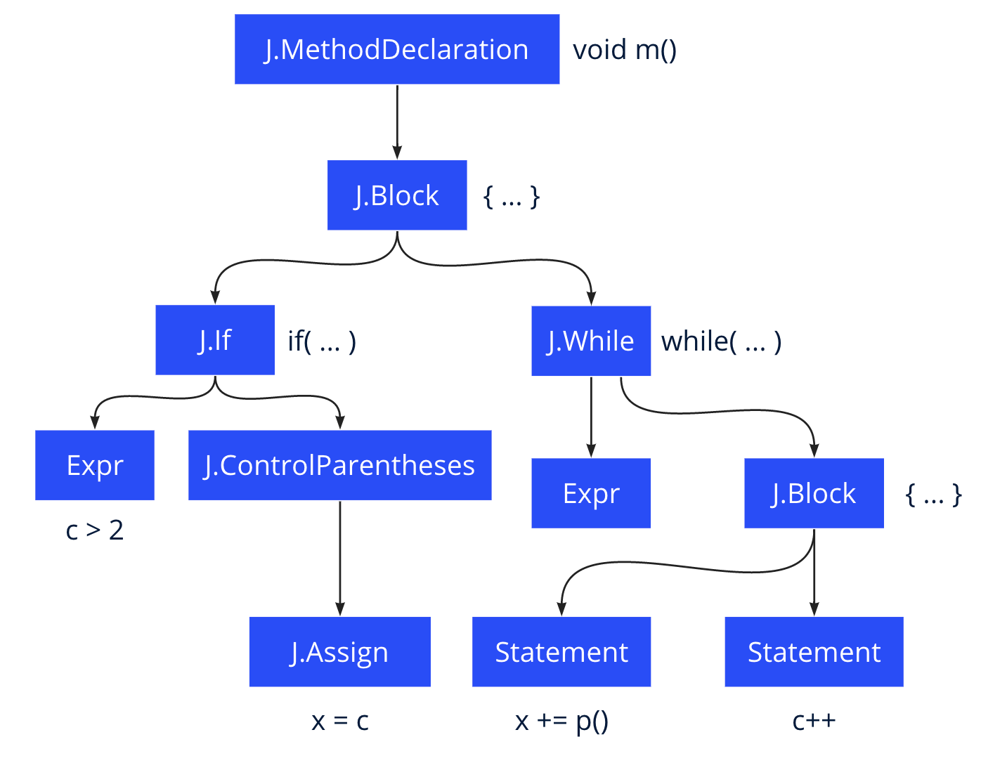
Built on an abstract syntax tree that preserves formatting and type information.
TRANSFORMATION.
Rewrite turns code into a tree

Slide 5
Capabilities available now
USE CASES.
Basic recipes: AutoFormat, FindType, ChangeType, ChangeMethodName
Best Practices: Spring, JUnit, security, code cleanup
Framework migrations: JUnit 4 to 5, Spring Boot 1 to 2
Maven dependency management: transitive dependency search, upgrade, exclusion
Custom recipes: remove unused LaunchDarkly flags, migrate internal APIs, fix CVEs
Infrastructure as Code: YAML, Kubernetes

Slide 6
Thanks for coming. We need your help!
CONCLUSION.
We hope everyone will:
Star or follow: github.com/openrewrite/rewrite
Open at least one issue on Github asking for a fix/migration you’d like to see. Ask for anything!
Follow @moderneinc on Twitter.
We hope most of you will:
Go to https://moderne.io/, and fill out the simple form. We’ll invite you to log in and play with the UI shortly.

